Slide 1

Unsupervised knowledge distillation for multiple Blackbox ML pipelines

Slide 2
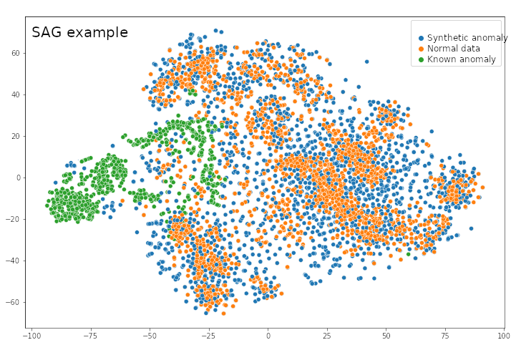
Brief and Goals
Knowledge distillation (KD) - process of transferring knowledge from a large model (teacher) to a smaller one (student) while keeping maximum knowledge capacity (without loss of validity). Distilled model is optimized for running on edge devices with limited computation resources.
KD could be done with one already trained block box model or even several models that share certain inputs (e.g., dependent subsystems in a car).
In anomaly detection domain to utilize teacher knowledge the most effective way, KD often implies detecting anomalies in unknown conditions which is often called in literature covariate shift and, therefore, connected to synthetic anomaly generation (SAG) or gap filling (GF)
Step 1 (Pipeline)
Step 2 (SAG)
Step 3 (KD)
Use teacher model and synthetic data to train student model
Train big teacher model (pipeline execution)
Generate synthetic data for unseen anomalies
Step 4 (Validation)
Validate student model accuracy vs teacher model accuracy

Slide 3
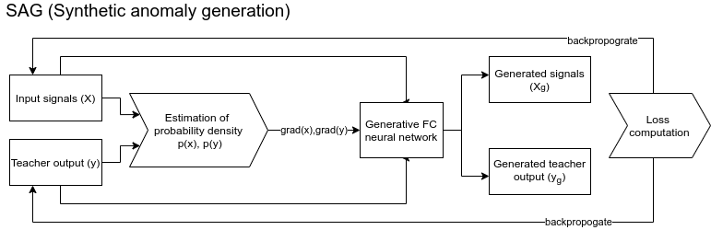
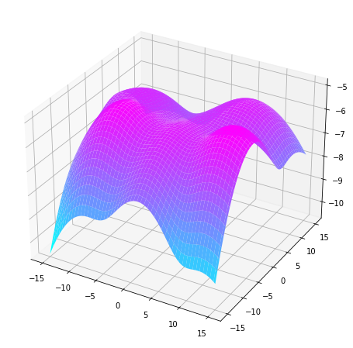
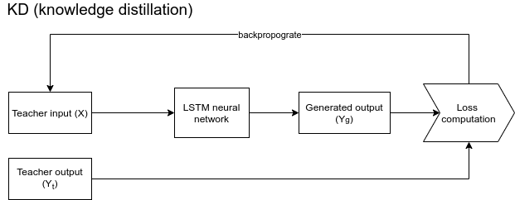
Implementation
Probability density surface p(y) (2D case)
L_{SAG} = (y_{g}- T(x_{g})) + p^{x}(x_{g}) + p^{y}(y_{g}) - cos(x-x_{g}, grad(p^{x}(x)) - cos(y-y_{g}, grad(p^{y}(y)), where T is a teacher model
L_{KD} = (y_{g}-y_{t})²

Slide 4
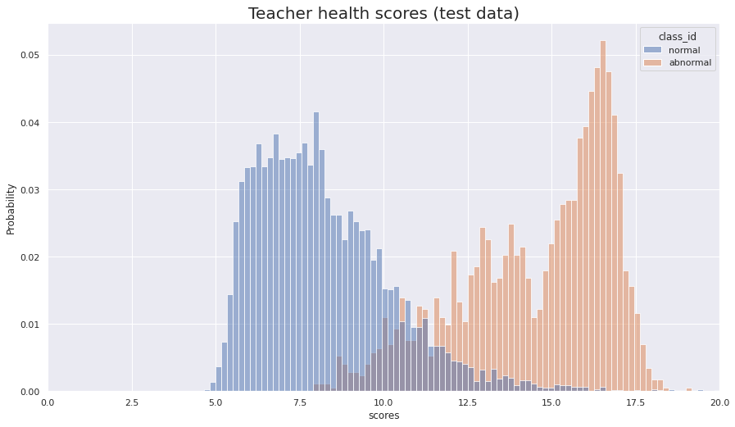
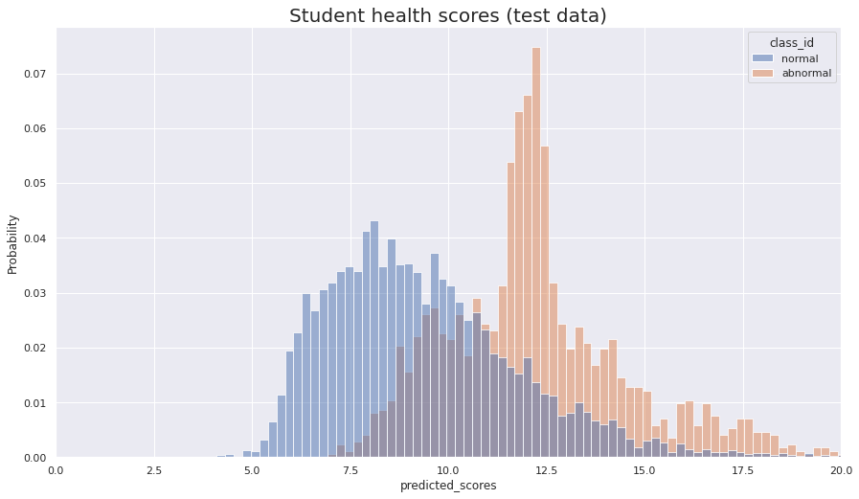
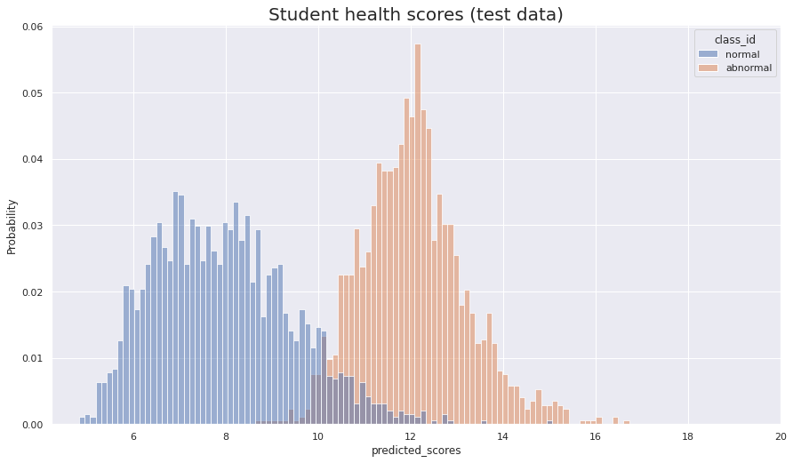
Results
Student
KD with SAG

Slide 5
Edge optimization and model fusion
A distilled model is expected to be run on edge device (vehicle). For this purpose, agnostic inference framework is used (ONNX, TVM).
Model can be converted to the unified format from popular frameworks such as Pytorch, Tensorflow, Caffe. Converted model presents computation graph with parameters written in pure C or C++ which is fast and agnostic to inference environment. No need to python interpreter, etc
During converting optional optimization can be applied to the model (e.g. parameter quantization)
Currently there is a need to convert Pytorch model to ONNX first because ONNX converter is more elaborated and contains operator. ONNX is converted then to TVM.
Step 1 (N teachers training)
Step 3 (ONNX model fusion)
Convert model to ONNX
Train multiple black box models
Knowledge distillation with synthetic data
Step 4 (TVM convertion)
Step 2 (One student KD)
Convert ONNX to TVM

